Slide 1
“CHARACTERISTICS OF EFFECTIVE INFORMATIVE SPEAKING”
Communication and Presentation Skills
Department of Computer Science
FAST NU Peshawar
Lecture by Ms. Maryam Ali Khan

Slide 2
INFORMATIVE SPEECH
A speech whose goal is to explain or describe facts, truths, and principles in a way that increases understanding

Slide 3
CHARACTERISTICS OF EFFECTIVE INFORMATIVE SPEAKING
Intellectually stimulating
Relevant
Creative
Memorable
Addressing diverse learning styles

Slide 4
1. INTELLECTUALLY STIMULATING
Information is intellectually stimulating when:
  New(unfamiliar topic or fresh insight to an already familiar topic)
  Instills curiosity or interest
How to tap curiosity if audience is unfamiliar with your topic?
  Imagine you are an anthropology major who is interested in prehistoric humans which is not an interest shared by most members of your audience, you know that in 1991, the 5,300-year-old remains of a man, now called Otzi were found surprisingly well preserved in an ice field. Even tough the discovery was big news at the time, your audience today probably doesn’t now much about it. You can draw their natural curiosity, however, as you present “Unraveling the Mystery of the Iceman”, describing scientists’ efforts to understand who Otzi was and what happened to him.”

Slide 5
How to identify fresh insight about a topic your audience is already familiar with?
  Ask yourself, “what things about my topic do listeners probably now know?”→answer this considering the depth and breadth
DEPTH:
  going into more details than people’s general knowledge
  Take example of Food Network, most people know basic recipes but these programs show new ways to cook the same foods

Slide 6
BREADTH:
  Looking at how your topic relates to associated topics.
  Trace considered breadth when he informed his audience about Type 1 diabetes. He discussed not only the physical and emotional effects of the disease on a diabetic person, but also the emotional and relational effects on family and friends, as well as the financial effects on society.

Slide 7
2. RELEVANT
Don’t assume that your listeners will recognize how the information is relevant to them but incorporate listener relevance links.
How would knowing this information make my listeners happier, healthier, wealthier, wiser, and so forth?

Slide 8
3. CREATIVE
Use information in a way that yields innovative ideas and insights
Creativity is a result of hard work and comes from:
  Good research
    The more you learn about a topic, the more you have ideas to develop creatively
  Taking time
    Consider a draft prepared days before you presentation where you have enough time to make it more creative
  Practicing productive thinking
    Contemplating something from a variety of perspectives

Slide 9
TACTICS OF PRODUCTIVE THINKING
Rethink a problem, issue, or topic from many perspectives. Albert Einstein actually came up with the theory of relativity doing this. As you brainstorm, try to think about a possible topic as it might be perceived by many different groups and co-cultural groups. Then as you conduct a research, try to find sources that represent a variety of viewpoints and perspectives, as well.
Make your thoughts visible by sketching drawings, diagrams, and graphs. Galileo revolutionized science by doing this. Concept mapping is an example of doing so when generating possible topics.

Slide 10
3. Produce. Set regular goals to produce something. The great NHL hockey player, Wayne Gretzky, put it this way: “You miss every shot you don’t take.” so take some shots! Thomas Edison actually set a goal to produce and invention every 10 years. J. S Bach wrote one cantata a week. You need to start somewhere.
4. Combine and recombine ideas, images, and thoughts in different ways. The Austrian monk, Gregor Mendel, combined mathematics and biology to come up with the laws of heredity, which still ground the modern science of genetics today.

Slide 11
APPLYING PRODUCTIVE THINKING
Suppose you want to give a speech on volunteering in the United States, and in your research, you ran across the date shown in the figure on the next page.

Slide 12
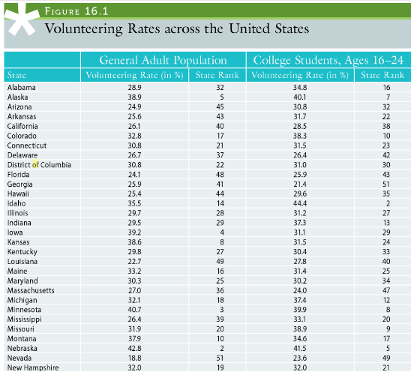

Slide 13
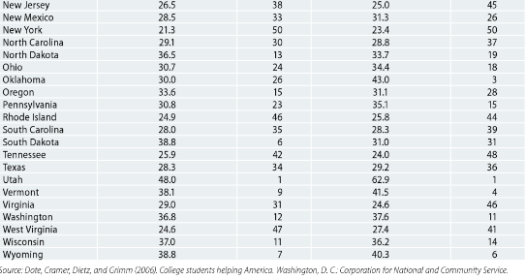

Slide 14
With productive thinking, you can identify several ways to develop your speech.
Notice that roughly two-thirds of the state’s college students(ages 16-24) volunteer as uch as or ore than the general adult population. You could investigate why this is so and do a speech about it.
Looking at the data from another perspective, you might notice that the percentage of both the general adult and college student populations that volunteer in three states(Minnesota, Nibraska, and Utah) is 40% or more. You might examine what types of volunteer work people do in those states and why.

Slide 15
4. MEMORABLE
Informative speech gives the audience enough information to remember

Slide 16
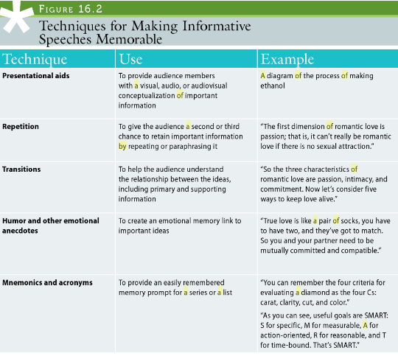

Slide 17
5. ADDRESSING DIVERSE LEARNING STYLES
People differ in how they prefer to learn
Feeling dimension→ concrete, vivid images, examples, stories, and testimonials
Watching dimension→ visual aids
Thinking dimension→ definitions, explanations and statistics
Doing dimension→ engage listener in some activity

Slide 18
TASK
Which dimension(s) do you prefer and why?

